Slide 1
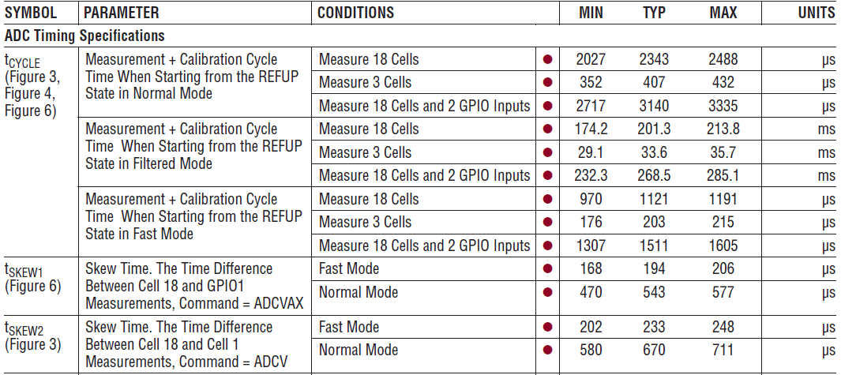
LTC6813 PCN Datasheet Changes
LTC6813-1
 | MIN (OLD) | MIN (NEW)
t_{CYCLE} | 2027 | 1743
 | 352 | 303
 | 2717 | 2337
 | 174.2 | 150.0
 | 29.1 | 25.0
 | 232.3 | 200.0
 | 970 | 834
 | 176 | 151
 | 1307 | 1124
t_{SKEW1} | 168 | 144
 | 470 | 404
t_{SKEW2} | 202 | 174
 | 580 | 500

